Slide 1
GROUP G WIL
SALON APPLICATION
GROUP MEMBERS:
DYWILI M – 218008473
BALOYI M. S – 219012179
LANDMAN S. B – 217003250
NDHUKULA M. N - 219007085

Slide 2
Summary
Problem
solution

Slide 3
Design phase – phase 2
Use case
Uml class diagram
ErD diagram
Ui design

Slide 4
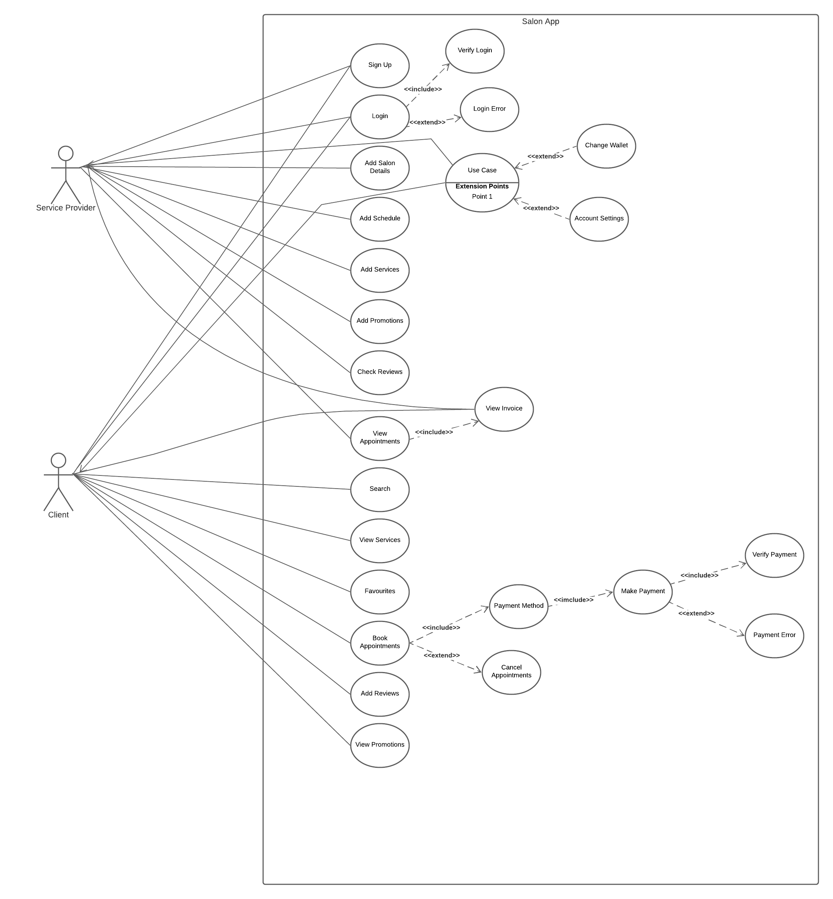
Use case

Slide 5
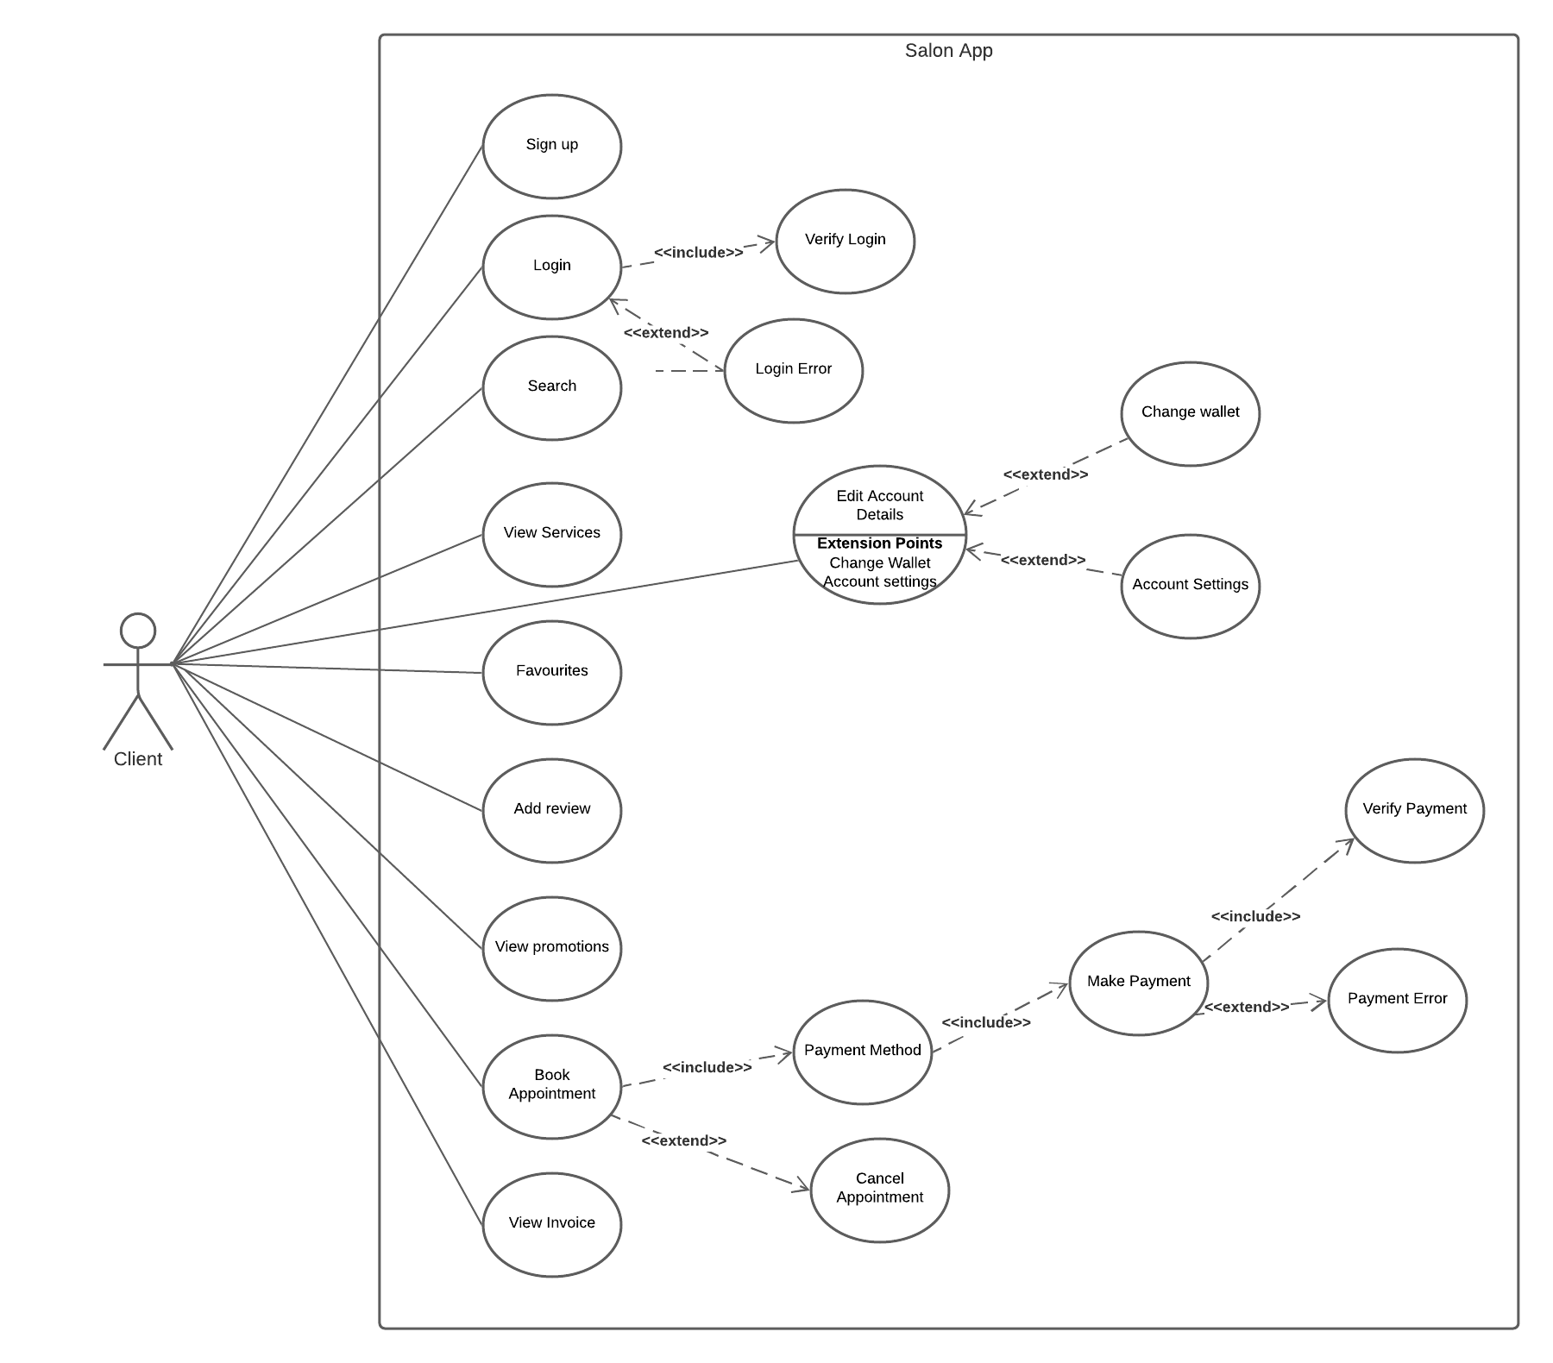

Slide 6
Use Case: the client Sign IN, Login, Search, book or add reviews Brief Description: client Sign in or login, search for salons, book appointments or adding reviews on the application Step By Step Description: 1. Sign in details may be entered by the client when its his/her first time using the app 2. when the client already have an account, they will only verify the login details 3.client will click “sign in” button to get him/her registered 4. the client can search for salons on the app and also book appointments by the app

Slide 7
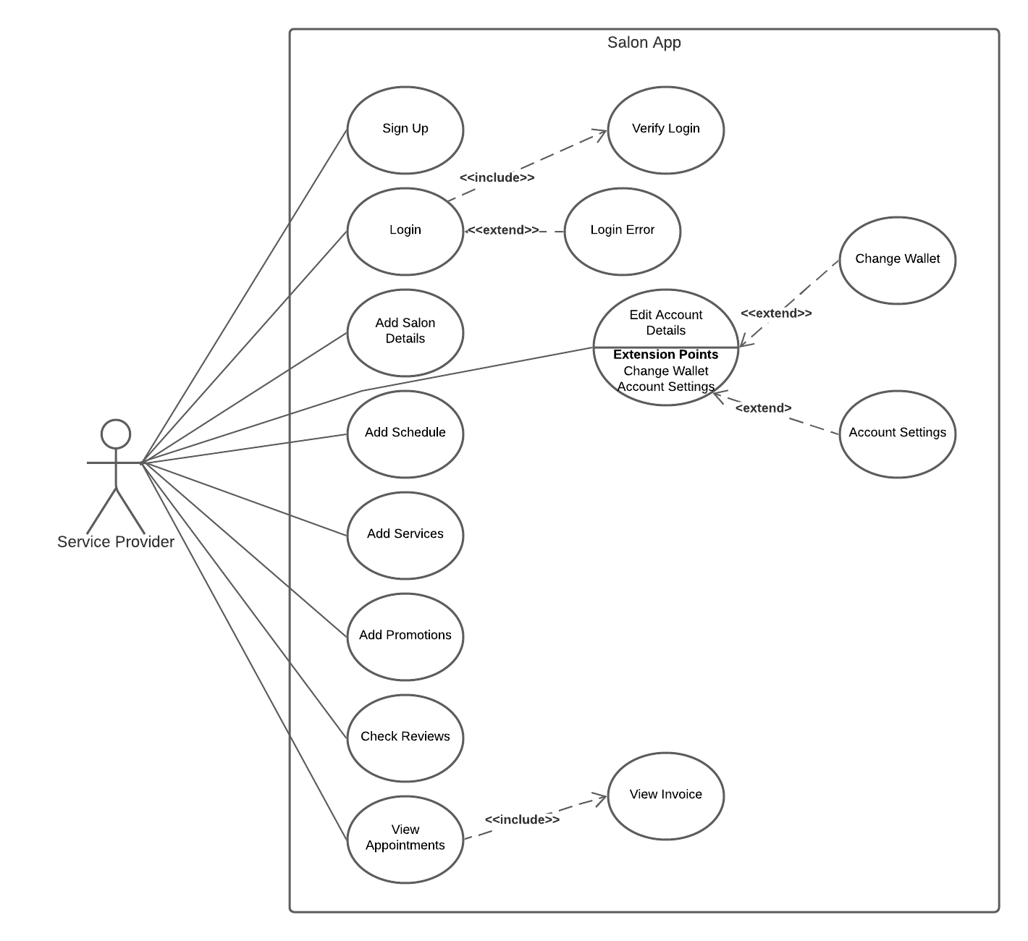

Slide 8
Use Case: the service provider sign in, login, add services, view appointments Brief Description: the service provider sign in, login, upload types of services and salon details, or view appointments on the application Step By Step Description: 1. service provider can register their salon on the app by signing in then enter their salon details and the salon’s name 2. service provider can enter the salon’s address 3. The service provider can upload pictures of hair styles 4. The service provider can upload pictures of the environment 5. The service provider can browse the hairstyles and check the reviews of customers 6. the service provider can view the appointments made.

Slide 9
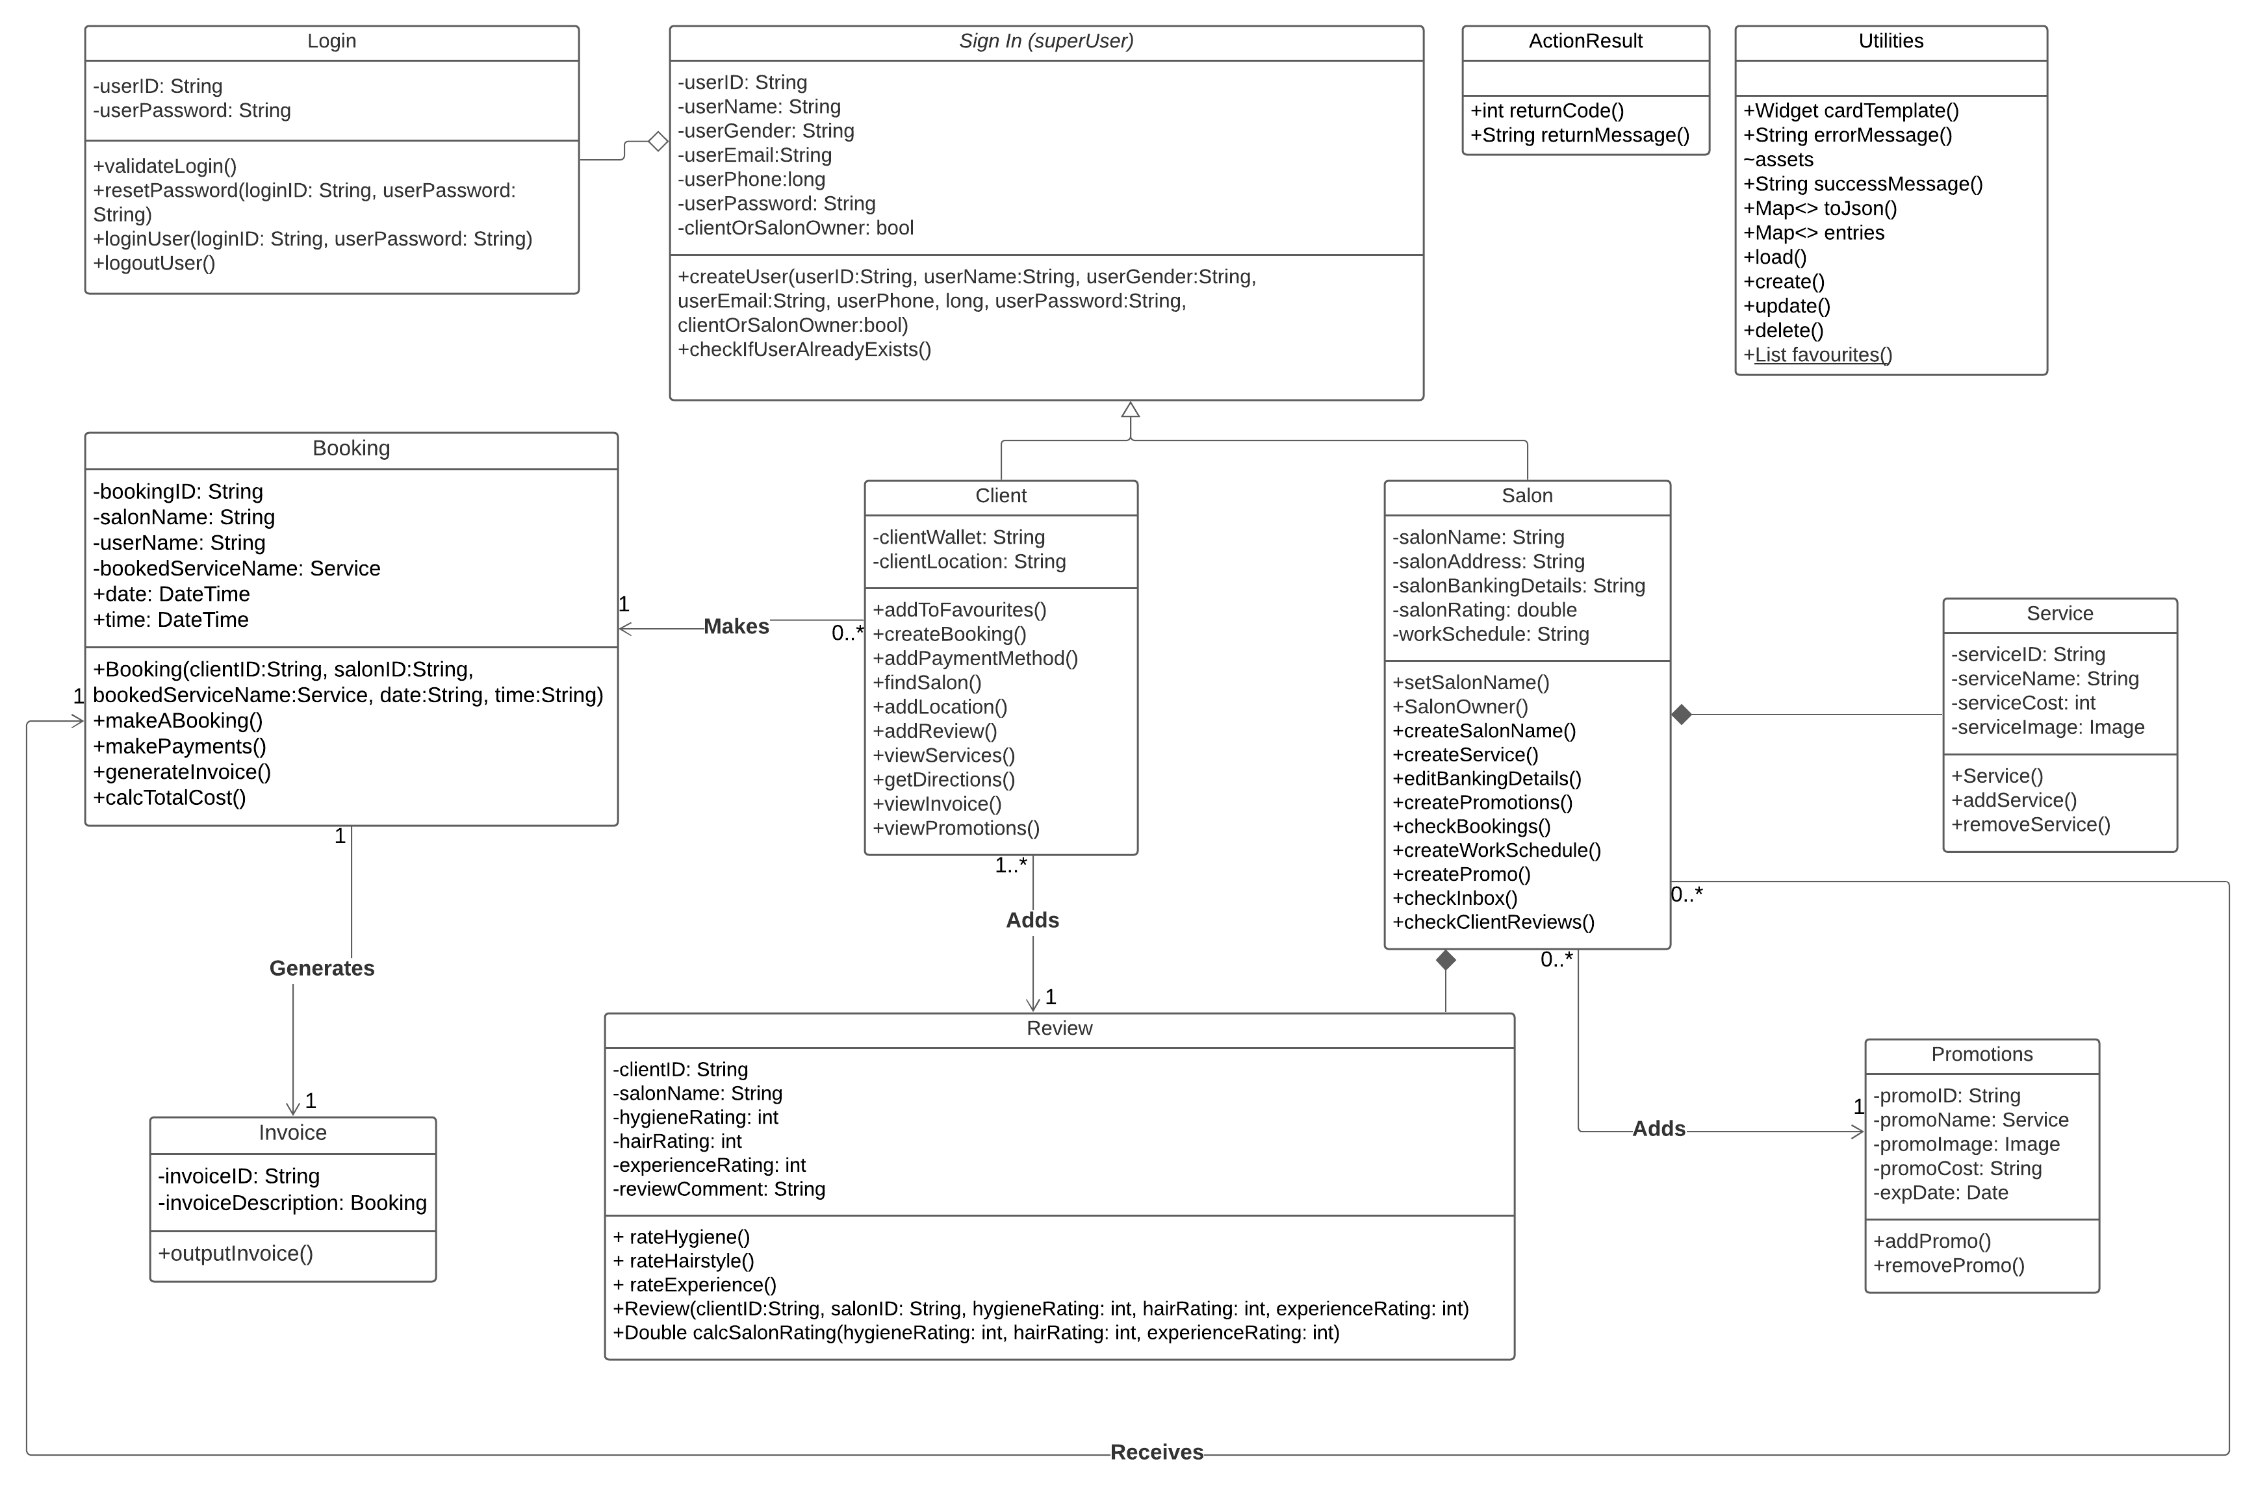
Uml class diagram

Slide 10
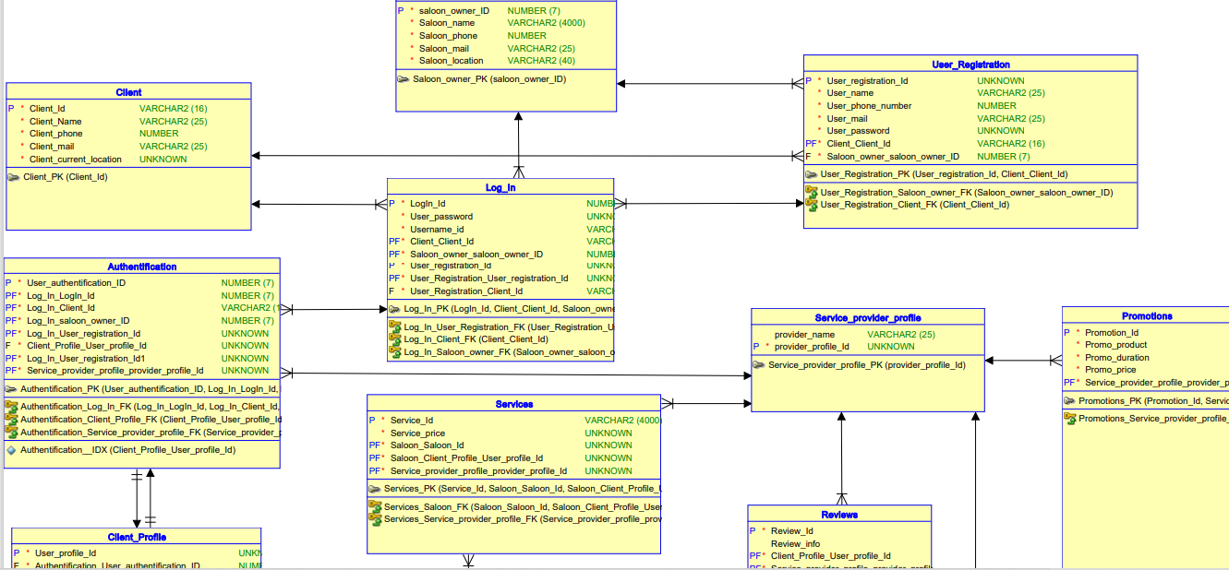
Er diagram

Slide 11
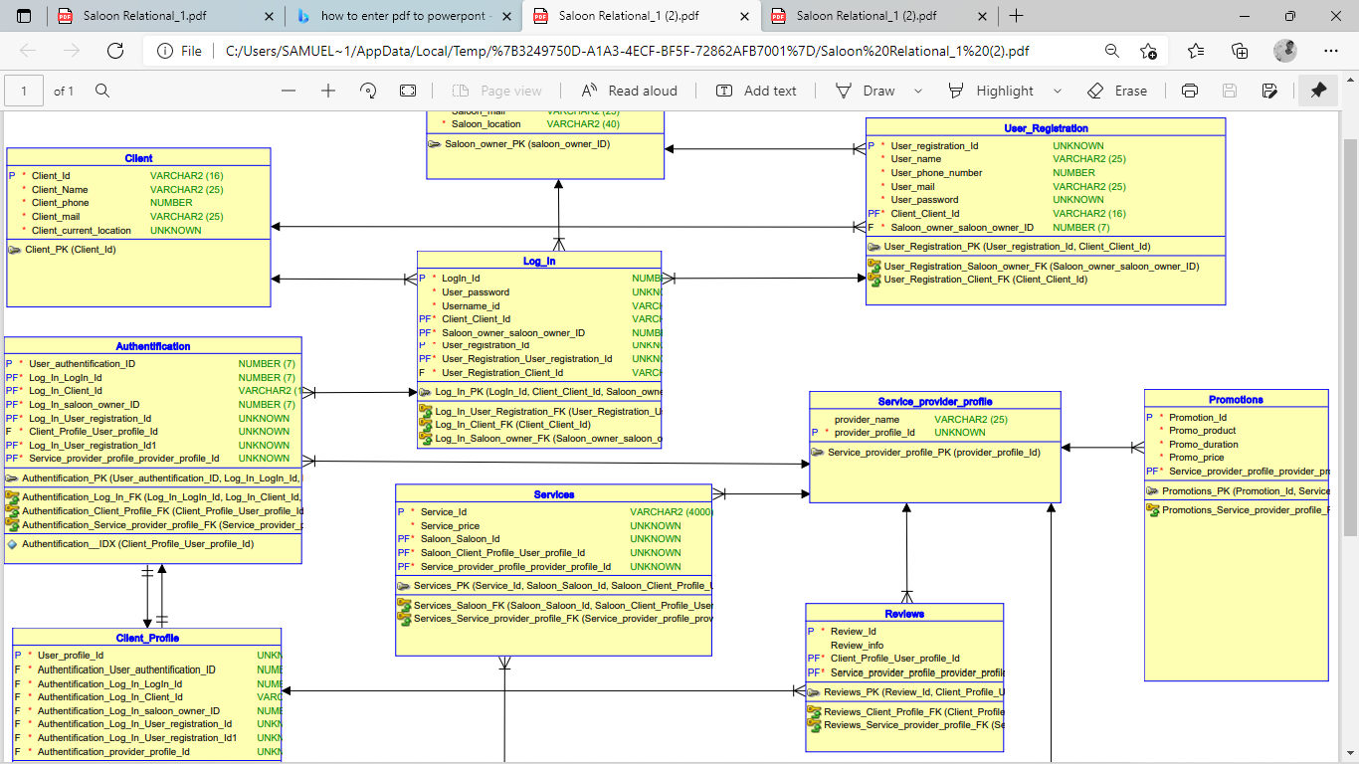

Slide 12
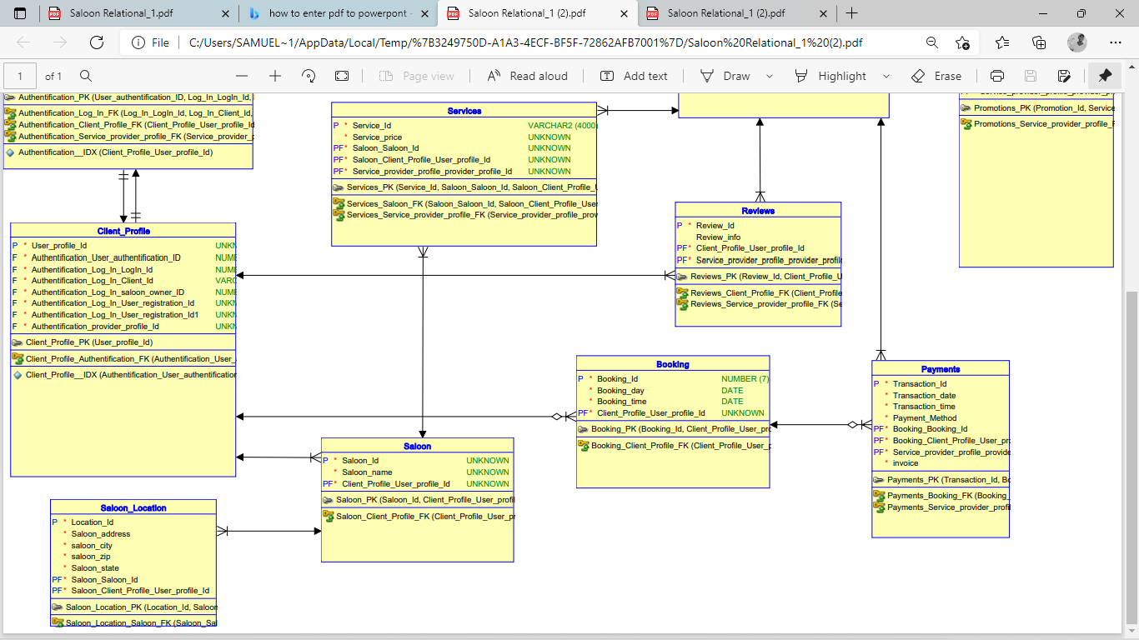

Slide 13


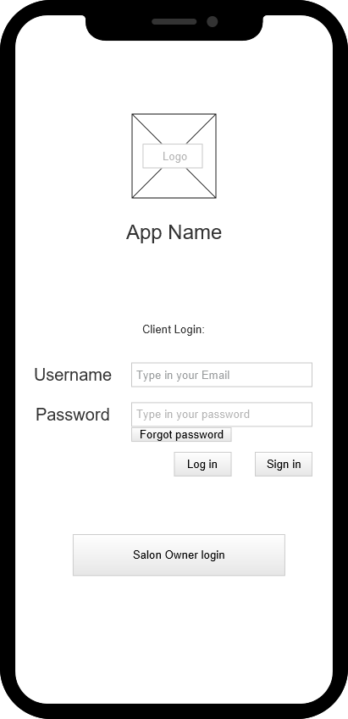
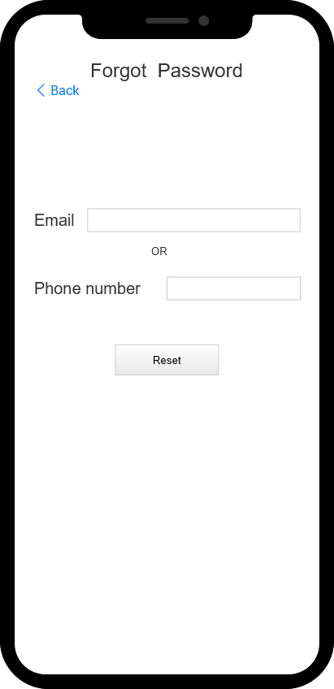
Ui design

Slide 14
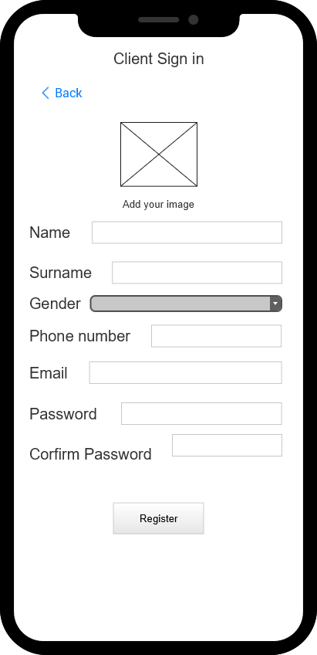
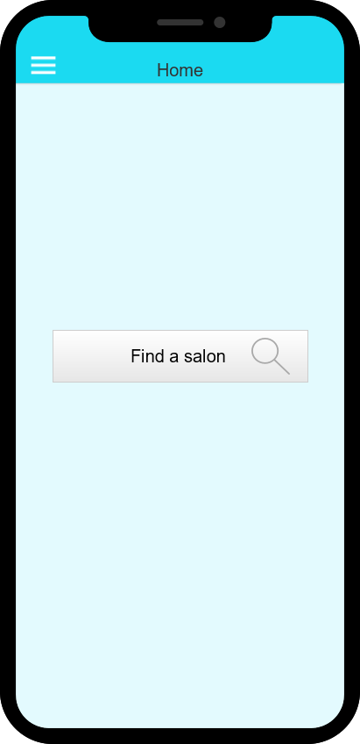

Slide 15
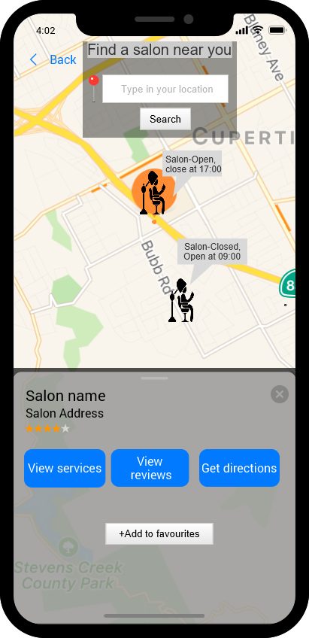
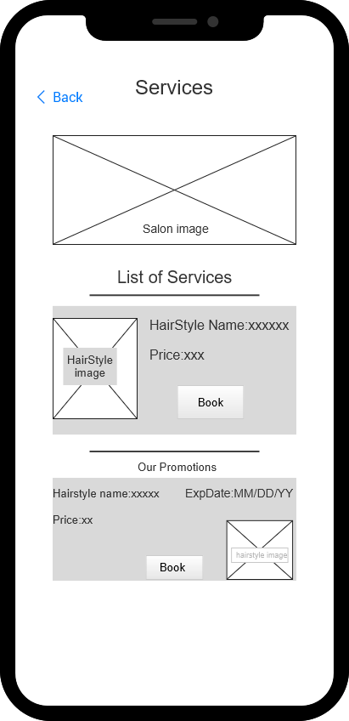

Slide 16
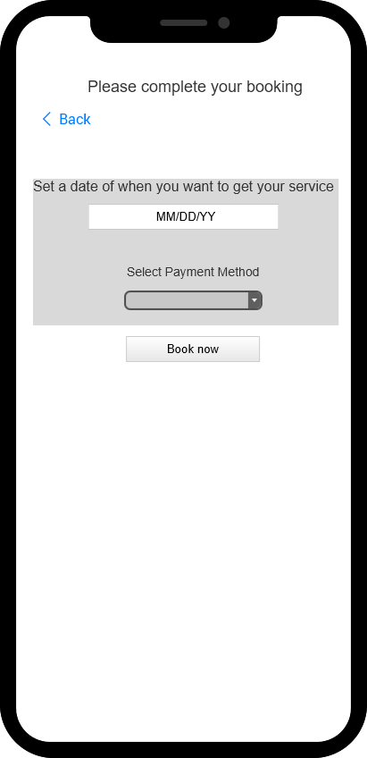
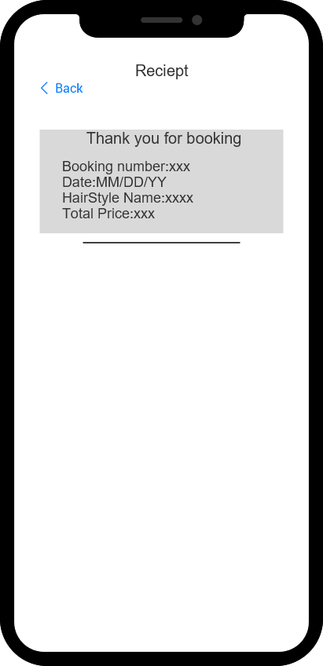

Slide 17
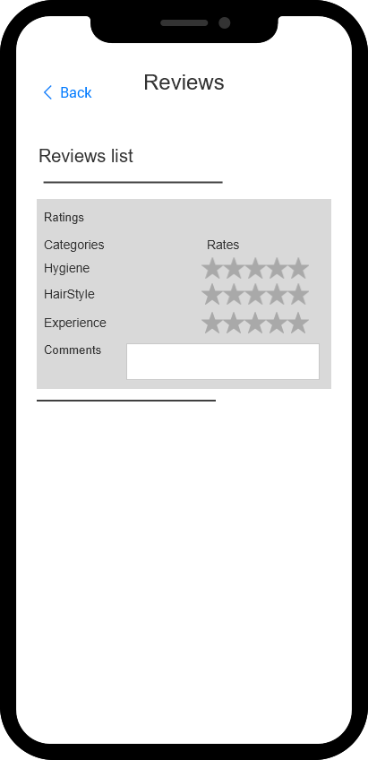
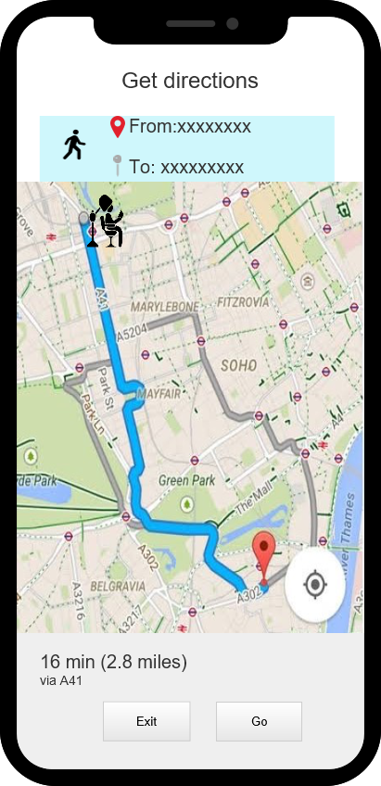

Slide 18
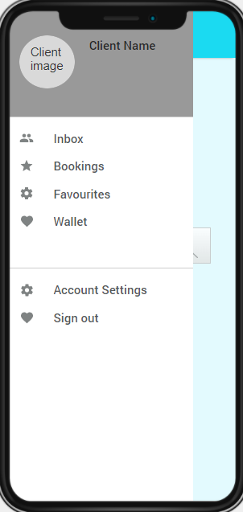
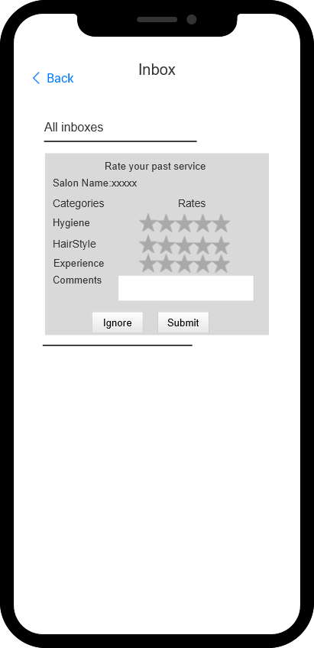
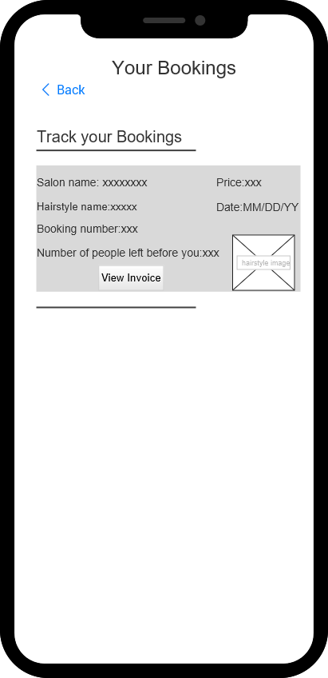

Slide 19
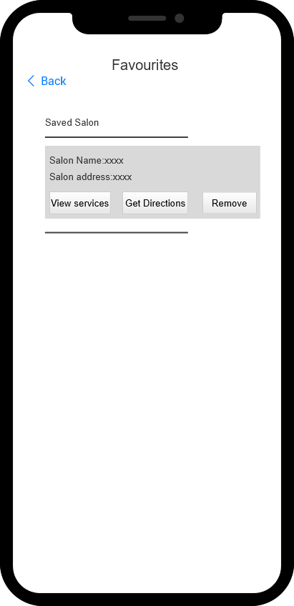
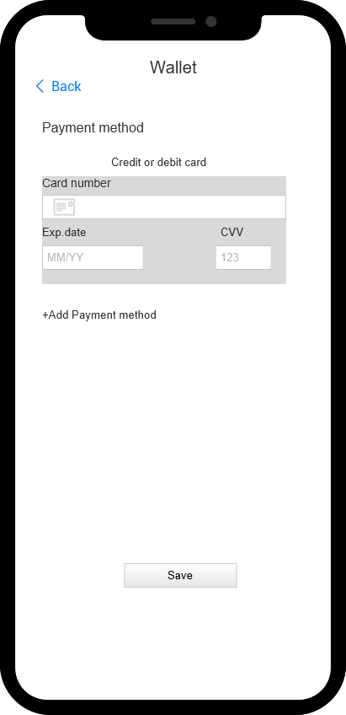

Slide 20

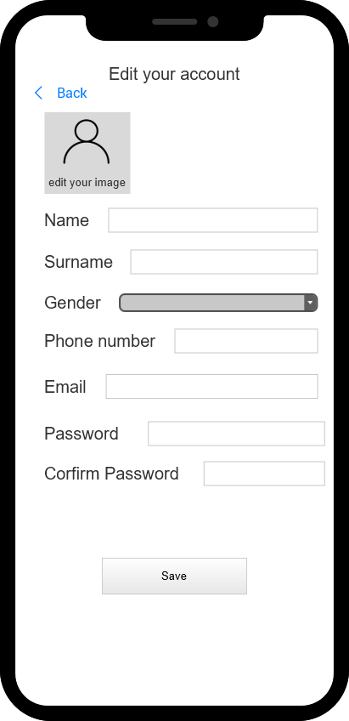

Slide 21
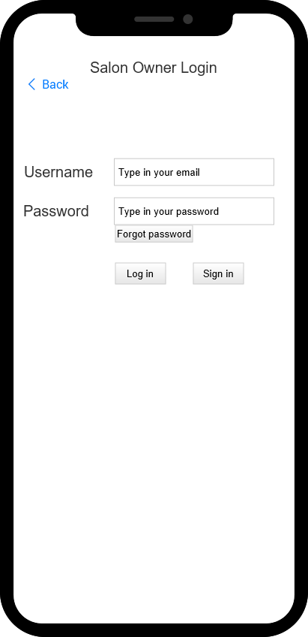
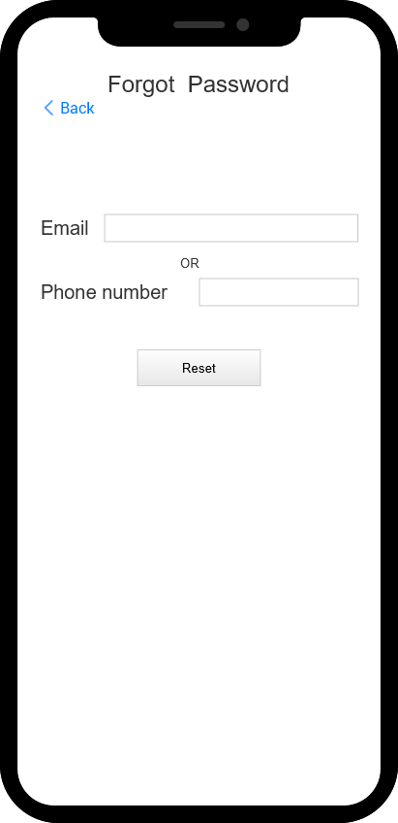

Slide 22
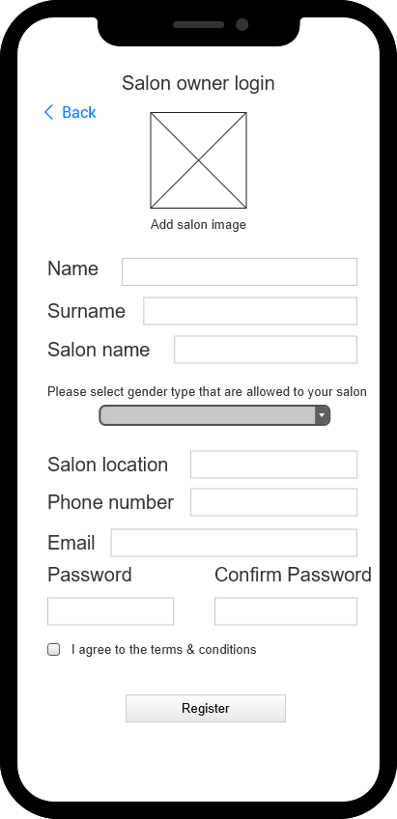
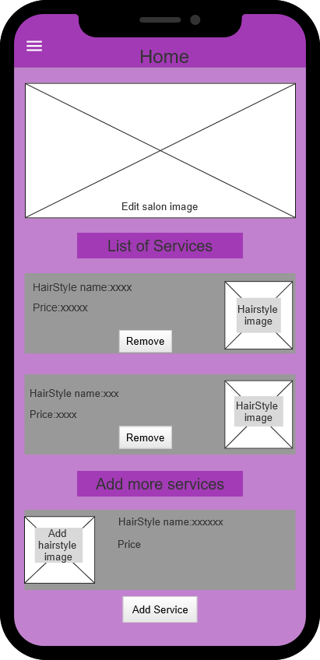

Slide 23
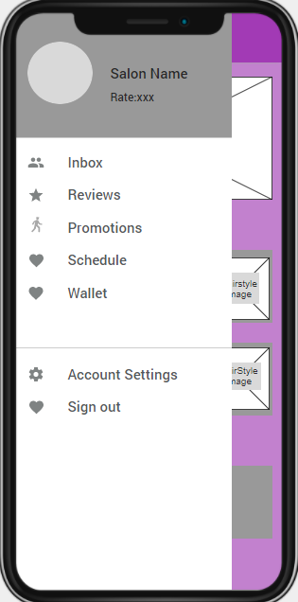
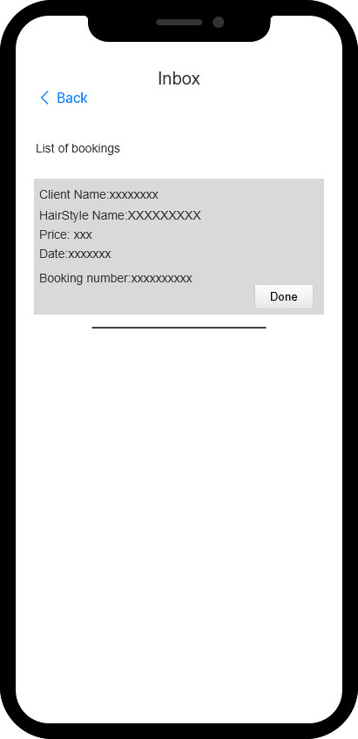
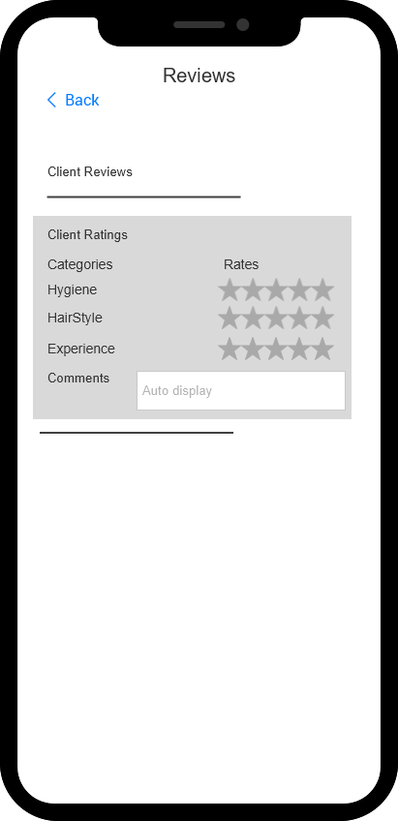

Slide 24
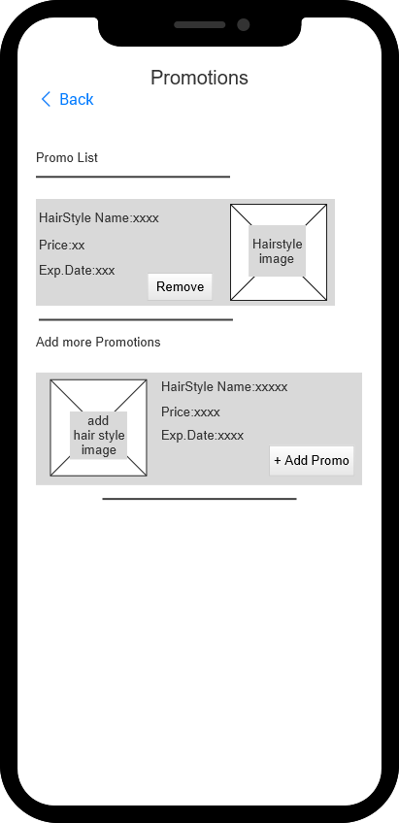
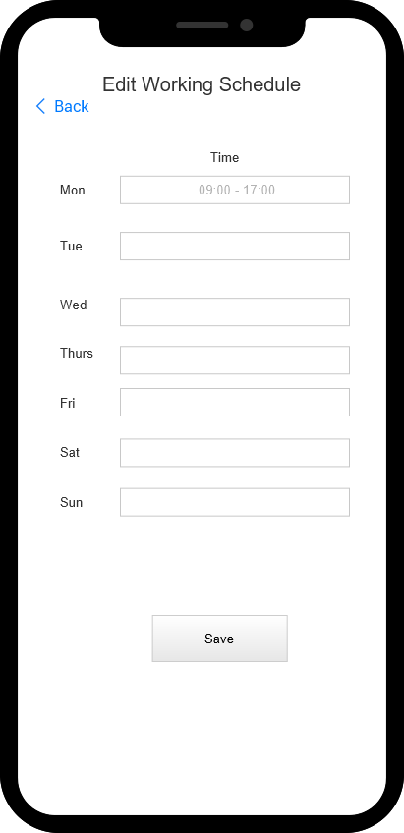

Slide 25
